Slide 1
Evaluation question 2…
By
Sam bothamley

Slide 2
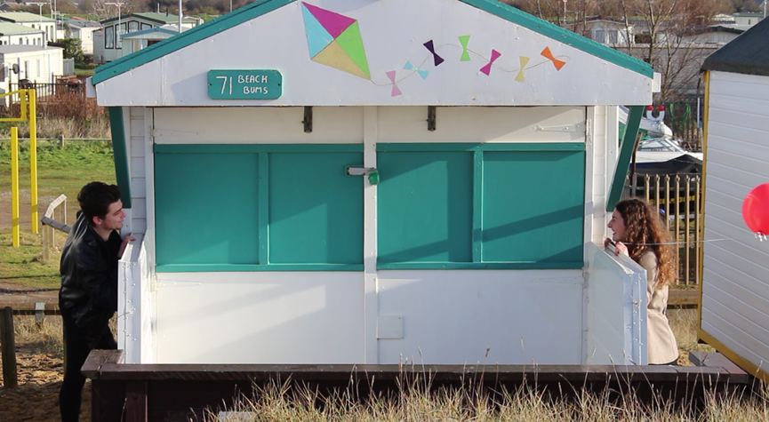
How effective is the combination of your main product (video) and ancillary texts (digipak/website/ advertisement)?

Slide 3
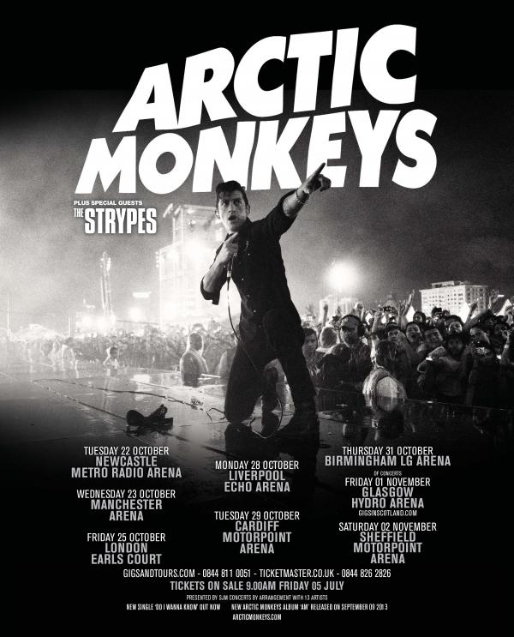
Brand Identity…
In the world of music video creation, similar to the outside world and normal companies, brand identify is vital in order to make yourself as niche as possible, it is so important to be unique. This makes a statement early and sets you apart from the competition in such a competitive market.
It also:
Makes it easier to identify the artist’s work
Makes clear connections with the artist
Makes a representation of the genre
Creates a genuine product to sell

Slide 4
My brand identity…
It can be very difficult to create brand identity when we are using an existing artist. However, I have managed to do so through attempting to use a level of consistency.
This is throughout my music video, digipak and magazine advert.
Examples of this include the background colouring in both the digipak and magazine advert being the same grey.
Another is the use of the same or similar images in both ancillary tasks as well as the video.
Another is the use of font on the digipak and the magazine, although I did use different fonts for different parts, this could possibly sway the tasks in terms of consistency.

Slide 5
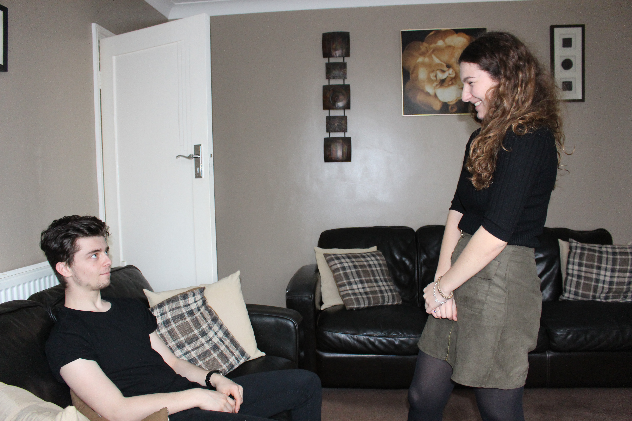
Consistent locations…
Throughout the three tasks, the locations have been kept the same, with a main three being used. This conforms with genre and Arctic Monkeys conventions of being diverse in terms of location.
We used:
The beach
Forest
House
All three of these link to the genre, artist and song itself. Due to the song being told in a narrative manner, I felt that this is an excellent way to tell the story.
These locations are also used on the digipak as well as the magazine advert, supporting the idea of consistency.

Slide 6
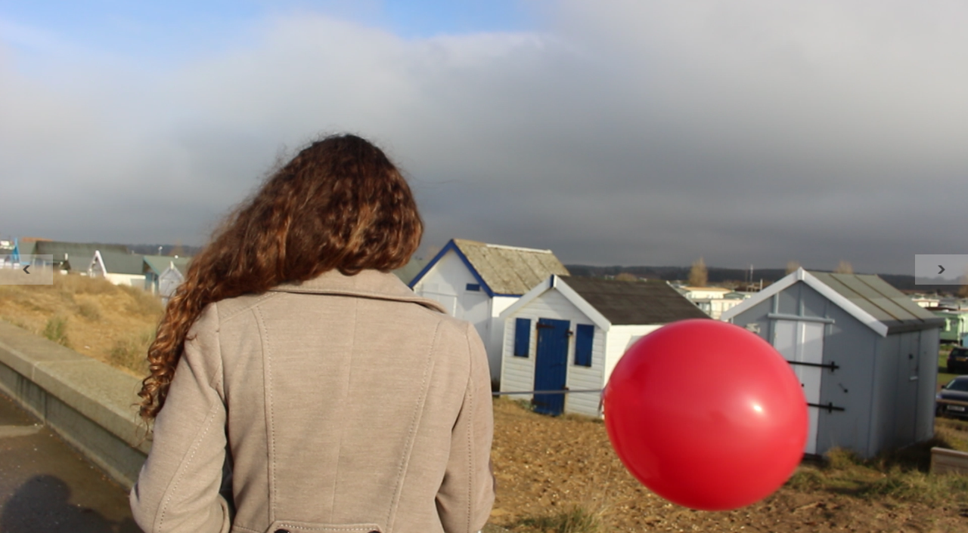
Consistent colour…
Colour is also very important in order to retain a high level of consistency within the media products.
In my products, I used a lot of darker colours such as black and grey as this conformed with the general stereotypes however I also attempted to break stereotypes slightly with occasional uses of red, particularly the balloon that is a reoccurring factor throughout the video and the ancillary tasks. This was done to purposely break the norm and make a statement.
When we talk about colour correction, in the music video in particular, I used a lot. As ‘Mardy Bum’ is about a ‘rocky’ relationship, I used warm colours (reds etc.) when the mood was a generally happy one, and damper colours (blues etc.) when the mood was a much darker one. This allowed the audience to infer the relationship status at that current time in the song. This can be seen in the next slide…

Slide 7
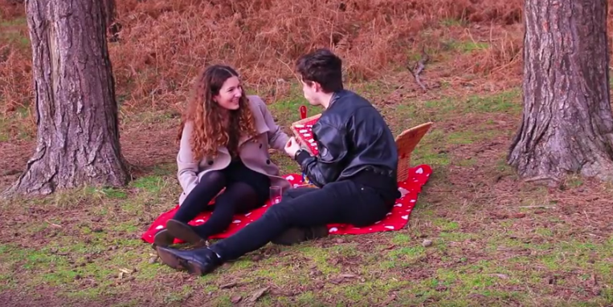
Warmer…

Slide 8
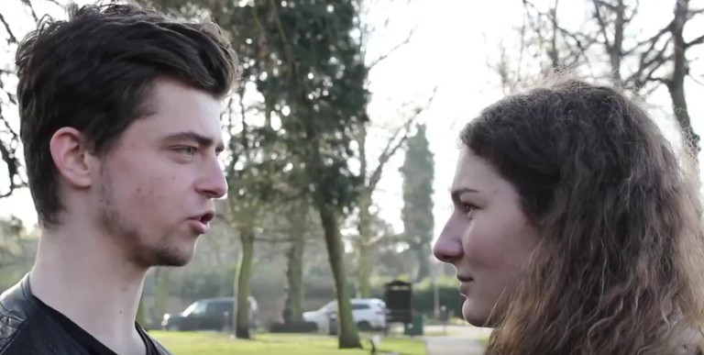
Darker…

Slide 9
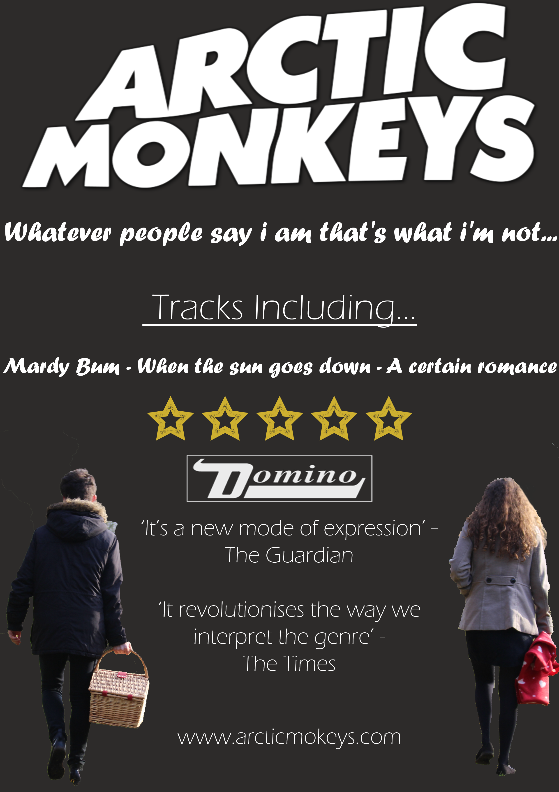
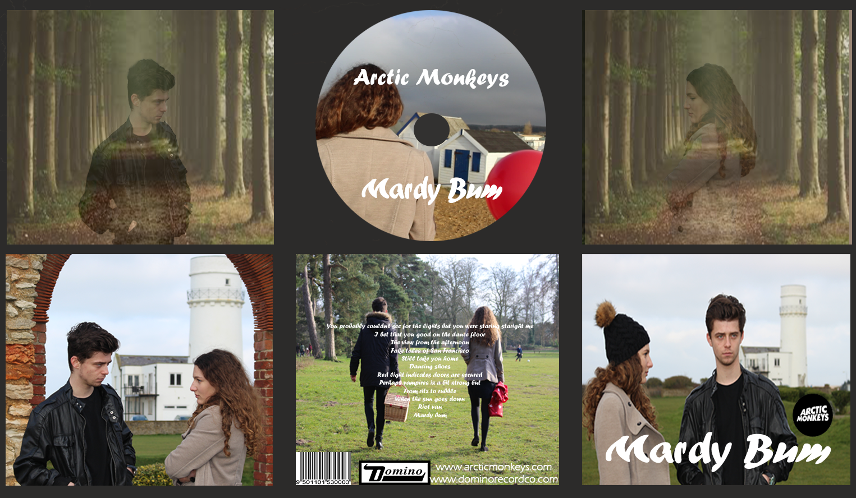
final comments…
In order for sales to be maximised, it is vital to create this brand identity. Through creating my consistency throughout the tasks, the audience can recognise the song from the ancillary tasks due to them linking to the music video. All of this ensures that the Arctic Monkeys are recognisable from any of the three tasks, this is what can help an artist become either successful or unsuccessful, it is heavily dependent in the brand identity.

